Slide 1
CS 211 Computer Architecture Lecture 32: Multicycle Datapath: Pipelining – 2 Pipelined Datapath, Structural Hazard
Ravi Mittal
ravi.mittal@iitgoa.ac.in
Indian Institute of Technology, Goa

Slide 2
Acknowledgements
Class Presentation, RISC-V CPU Control, Pipelinging, CS61C, Great Ideas in Computer Architecture, University of Berkeley, Morgan Rae Rechenberg
Class Presentation, CS61C, Machine Structures, University of Berkeley, Dan Garcia and Miki Lustig, 2019
Class Presentation, CS61C, Introduction to Assembly Language and RISC-V Instruction Set Architecture, University of Berkeley, Prof Krste Asanović & Randy H. Katz. http://inst.eecs.Berkeley.edu/~cs61c
Computer Organization and Design, The Hardware Software Interface, RISC-V edition, Patterson and Hennessey
Digital Design and Computer Architecture: RISC-V Edition, Harris & Harris Elsevier – Presentation.

Slide 3
In this lecture we will study
RISC-V Pipeline
Hazard
Structural Hazard

Slide 4
In the last class, we studied Pipelined Datapath – Concept

Slide 5
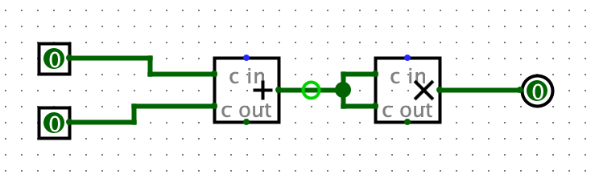
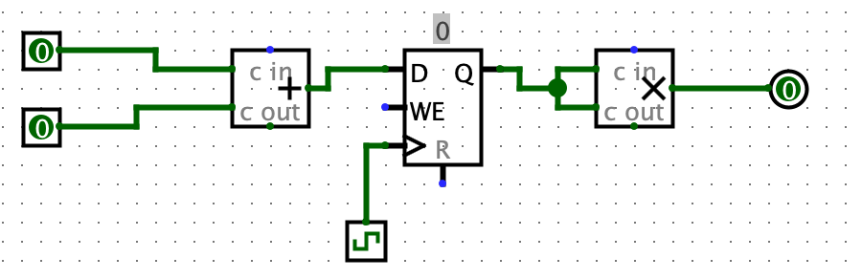
Quick review: Circuit pipelining!
When we calculate cycle time, or critical path, we do so between state elements, inputs, and outputs.
Adding registers between circuit components decreases our critical path and increases our frequency
Ref: CS61C Morgan Reschenberg, Univ of California, Berkeley

Slide 6







Pipelining with RISC-V
Phase | Pictogram | t_{step} Serial
Instruction Fetch |  | 200 ps
Reg Read |  | 100 ps
ALU |  | 200 ps
Memory |  | 200 ps
Register Write |  | 100 ps
t_{instruction} |  | 800 ps
t_{cycle} Pipelined
200 ps
200 ps
200 ps
200 ps
200 ps
1000 ps
t_{instruction}
add t0, t1, t2
or t3, t4, t5
instruction sequence
sll t6, t0, t3
t_{cycle}
Ref: CS61C Morgan Reschenberg, Univ of California, Berkeley
Notes:
Tc = “Time between completion of instructions”

Slide 7
Pipeline Performance
Tc - time between completion of instructions
to measure speedup
Speedup is due to increased throughput
Latency for each instruction does not decrease, in fact it may increase if our stages are uneven!
It takes longer for the first instruction to finish, but every instruction after finishes faster!
Ref: CS61C Morgan Reschenberg, Univ of California, Berkeley

Slide 8
Pipeline Performance
Assume time for stages is
100ps for register read or write
200ps for other stages
Compare pipelined datapath with single-cycle datapath
Instr | Instr fetch | Register read | ALU op | Memory access | Register write | Total time
ld (lw) | 200ps | 100 ps | 200ps | 200ps | 100 ps | 800ps
sd (sw) | 200ps | 100 ps | 200ps | 200ps |  | 700ps
R-format | 200ps | 100 ps | 200ps |  | 100 ps | 600ps
beq | 200ps | 100 ps | 200ps |  |  | 500ps
Ref: CS61C Morgan Reschenberg, Univ of California, Berkeley

Slide 9
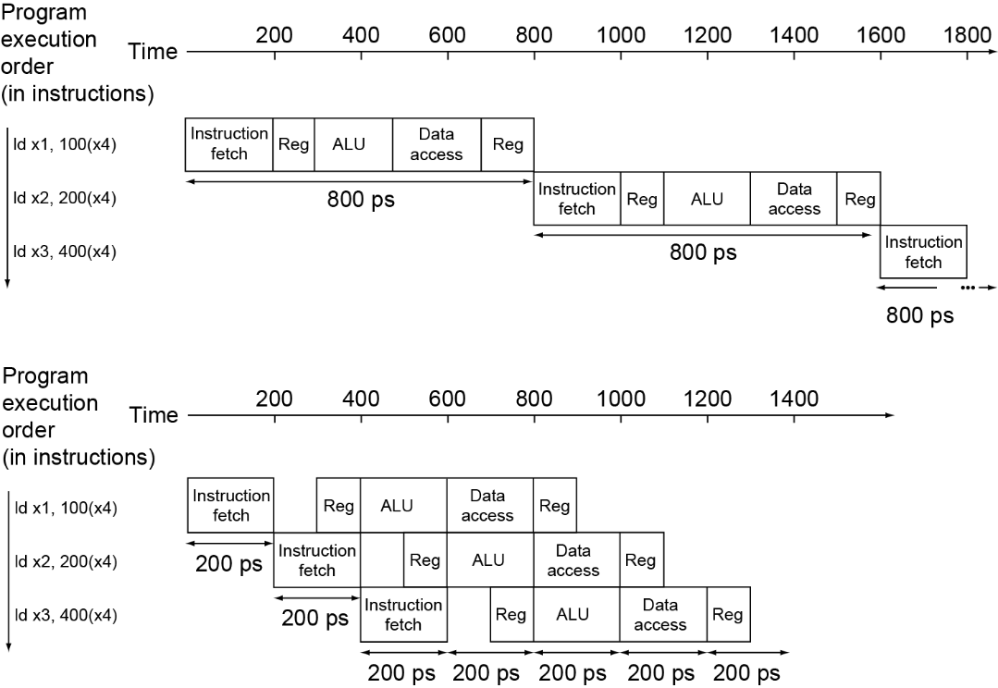
Pipeline Performance
Single-cycle (T_{c}= 800ps)
Pipelined (T_{c}= 200ps)
Ref: CS61C Morgan Reschenberg, Univ of California, Berkeley

Slide 10
Pipeline Speedup
If all stages are balanced
i.e., all take the same time
Time between instructions_{pipelined} = Time between instructions_{nonpipelined} Number of stages
If not balanced, speedup is less
Speedup due to increased throughput
Latency (time for each instruction) does not decrease
Ref: CS61C Morgan Reschenberg, Univ of California, Berkeley

Slide 11
RISC-V Pipeline

Slide 12
Pipelining with RISC-V
t_{instruction}
add t0, t1, t2
or t3, t4, t5
instruction sequence
sll t6, t0, t3
t_{cycle}
 | Single Cycle | Pipelining
Timing | t_{step} = 100 … 200 ps | t_{cycle} = 200 ps
 | Register access only 100 ps | All cycles same length
Instruction time, t_{instruction} | = t_{cycle} = 800 ps | 1000 ps
Clock rate, f_{s} | 1/800 ps = 1.25 GHz | 1/200 ps = 5 GHz
Relative speed | 1 x | 4 x
Ref: CS61C Morgan Reschenberg, Univ of California, Berkeley
Notes:
Tc = “Time between completion of instructions”

Slide 13
Sequential vs Simultaneous
What happens sequentially, what happens simultaneously?
t_{instruction} = 1000 ps
add t0, t1, t2
or t3, t4, t5
sll t6, t0, t3
instruction sequence
sw t0, 4(t3)
lw t0, 8(t3)
t_{cycle}
= 200 ps
addi t2, t2, 1
Ref: CS61C Morgan Reschenberg, Univ of California, Berkeley
Notes:
Tc = “Time between completion of instructions”

Slide 14
Instruction Level Parallelism (ILP)
Pipelining allows us to execute parts of multiple instructions at the same time using the same hardware!
This is known as instruction level parallelism
Ref: CS61C Morgan Reschenberg, Univ of California, Berkeley

Slide 15
Sequential vs Simultaneous
What happens sequentially, what happens simultaneously?
t_{instruction} = 1000 ps
add t0, t1, t2
or t3, t4, t5
sll t6, t0, t3
instruction sequence
sw t0, 4(t3)
lw t0, 8(t3)
t_{cycle}
= 200 ps
addi t2, t2, 1
Notes:
Tc = “Time between completion of instructions”

Slide 16
RISC-V Pipeline
t_{instruction} = 1000 ps
Resource use in a particular time slot
add t0, t1, t2
Resource use by instruction over time
or t3, t4, t5
slt t6, t0, t3
instruction sequence
sw t0, 4(t3)
lw t0, 8(t3)
t_{cycle}
= 200 ps
addi t2, t2, 1
Ref: CS61C Morgan Reschenberg, Univ of California, Berkeley

Slide 17
Single-Cycle RISC-V RV32I Datapath
+4
Reg[]
pc
pc+4
pc
wb
1
alu
alu
1
DataD
Reg[rs1]
ALU
DMEM
2
IMEM
inst[11:7]
AddrD
0
1
pc+4
0
Branch Comp.
Reg[rs2]
Addr
DataR
0
wb
inst[19:15]
AddrA
DataA
0
DataW
mem
inst[24:20]
AddrB
DataB
1
inst[31:7]
Imm.
Gen
imm[31:0]
PCSel
inst[31:0]
ImmSel
RegWEn
BrUn
BrEq
BrLT
BSel
ASel
ALUSel
MemRW
WBSel
Ref: CS61C Morgan Reschenberg, Univ of California, Berkeley

Slide 18
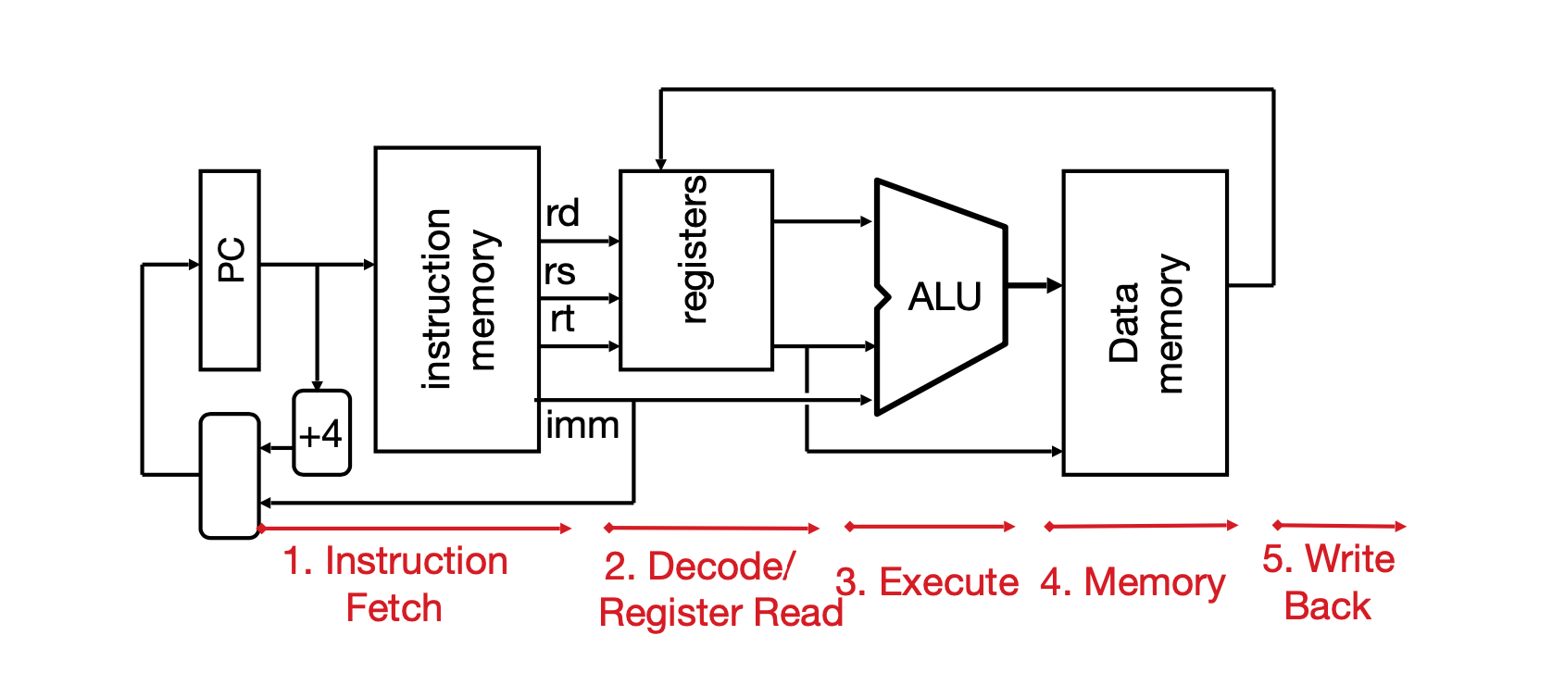
Single-Cycle RISC-V RV32I Datapath
Ref: CS61C Morgan Reschenberg, Univ of California, Berkeley

Slide 19
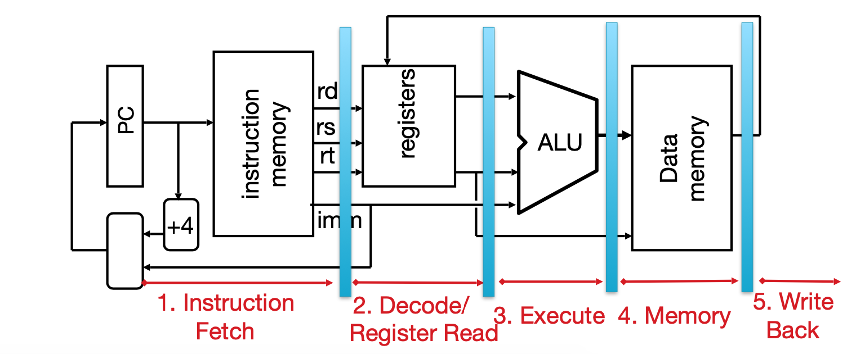
Pipeline Registers
Need registers between stages
To hold information produced in the previous cycle
Ref: CS61C Morgan Reschenberg, Univ of California, Berkeley

Slide 20
Pipelining RISC-V RV32I Datapath
+4
Reg[]
pc
pc+4
pc
wb
1
alu
1
DataD
Reg[rs1]
ALU
2
alu
0
DMEM
0
IMEM
inst[11:7]
AddrD
Addr
1
pc+4
Branch Comp.
Reg[rs2]
DataR
wb
inst[19:15]
AddrA
DataA
0
0
DataW
mem
inst[24:20]
AddrB
DataB
1
inst[31:7]
Imm.
Gen
imm[31:0]
Instruction Fetch
(F)
Instruction Decode/Register Read
(D)
ALU Execute
(X)
Memory Access
(M)
Write Back
(W)
NOTE: Control signals are also pipelined!
Ref: CS61C Morgan Reschenberg, Univ of California, Berkeley

Slide 21
Pipelined RISC-V RV32I Datapath
Recall that PC+4 value is required in jal, jalr instructions
Recalculate PC+4 in M stage to avoid sending both PC and PC+4 down pipeline
pc_{X}
pc_{M}
pc_{F}
pc_{D}
+4
+4
Reg[]
rs1_{X}
1
DataD
ALU
DMEM
alu_{X}
0
AddrD
Branch Comp.
alu_{M}
Addr
DataR
pc_{F}+4
IMEM
AddrA
DataA
DataW
AddrB
DataB
inst_{D}
rs2_{X}
rs2_{M}
Imm.
imm_{X}
inst_{X}
inst_{M}
inst_{W}
Must pipeline instruction along with data, so control operates correctly in each stage
Ref: CS61C Morgan Reschenberg, Univ of California, Berkeley

Slide 22
Each stage operates on different instruction
lw t0, 8(t3)
sw t0, 4(t3)
slt t6, t0, t3
or t3, t4, t5
add t0, t1, t2
pc_{X}
pc_{M}
pc_{F}
pc_{D}
+4
+4
Reg[]
rs1_{X}
1
DataD
ALU
DMEM
alu_{X}
0
AddrD
Branch Comp.
alu_{M}
Addr
DataR
pc_{F}+4
IMEM
AddrA
DataA
DataW
AddrB
DataB
inst_{D}
rs2_{X}
rs2_{M}
Imm.
imm_{X}
inst_{X}
inst_{M}
inst_{W}
Pipeline registers separate stages, hold data for each instruction in flight
Ref: CS61C Morgan Reschenberg, Univ of California, Berkeley

Slide 23
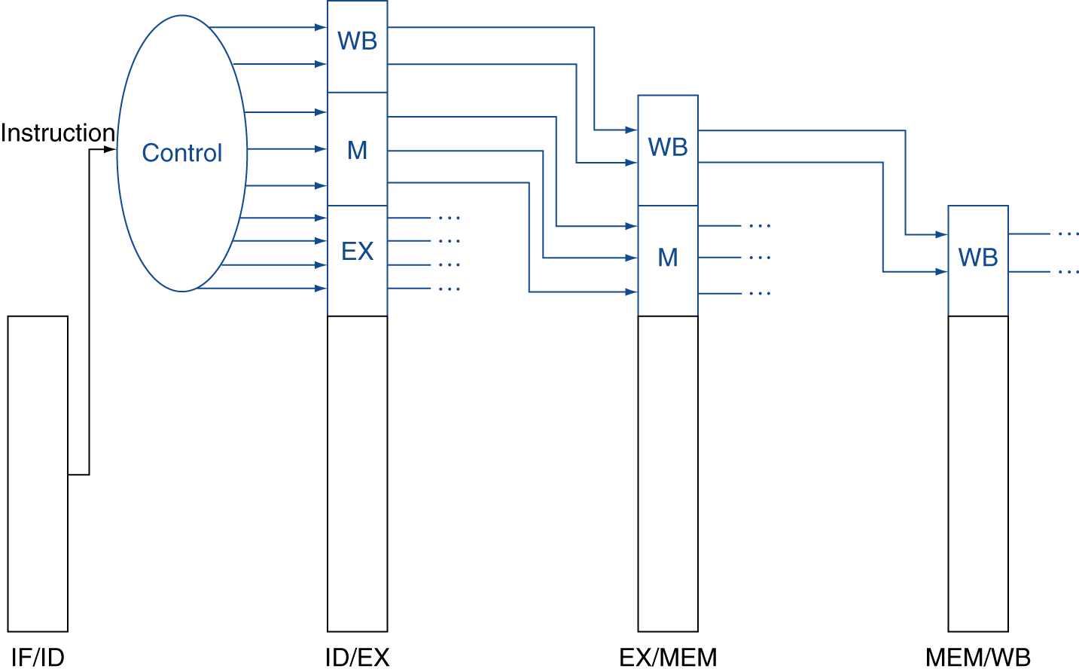
Pipelined Control
Control signals derived from instruction (as in single cycle implementation)
Information is stored in pipeline registers for use by later stages
Ref: CS61C Morgan Reschenberg, Univ of California, Berkeley

Slide 24
Trivia
Assume the stage times shown below. Suppose we remove loads and stores from our ISA. Consider going from a single-cycle implementation to a 4-stage pipelined
Instr Fetch | Reg Read | ALU Op | Mem Access | Reg Write
200ps | 100 ps | 200ps | 200ps | 100 ps
What is throughput speedup?
What is the latency (instruction level)?
Ref: CS61C Morgan Reschenberg, Univ of California, Berkeley

Slide 25
Trivia
Assume the stage times shown below. Suppose we remove loads and stores from our ISA. Consider going from a single-cycle implementation to a 4-stage pipelined
Instr Fetch | Reg Read | ALU Op | Mem Access | Reg Write
200ps | 100 ps | 200ps | 200ps | 100 ps
Note that there is no memory access
Throughput Speedup:
Single Cycle: (IF+ID+EX+WB) = 600 ps
Pipeline: (4*max_stage)/4 = 200 ps
old/new = 600/200 = 3x faster
Ref: CS61C Morgan Reschenberg, Univ of California, Berkeley

Slide 26
Trivia
Assume the stage times shown below. Suppose we remove loads and stores from our ISA. Consider going from a single-cycle implementation to a 4-stage pipelined
Instr Fetch | Reg Read | ALU Op | Mem Access | Reg Write
200ps | 100 ps | 200ps | 200ps | 100 ps
Single Cycle Instruction latency:
IF+ID+EX+WB = 600 ps
Pipelined Instruction latency:
4*max_stage = 800ps
Latency speedup = 800/600 = 1.33 x slower
Ref: CS61C Morgan Reschenberg, Univ of California, Berkeley

Slide 27

Hazards

Slide 28
Pipelining Hazards
A hazard is a situation that prevents starting the next instruction in the next clock cycle
Structural hazard
A required resource is busy (e.g. needed in multiple stages)
Data hazard
Data dependency between instructions
Need to wait for previous instruction to complete its data read/write
Control hazard
Flow of execution depends on previous instruction
Ref: CS61C Morgan Reschenberg, Univ of California, Berkeley

Slide 29
Structural Hazard

Slide 30
Structural Hazard
Problem: Two or more instructions in the pipeline compete for access to a single physical resource
Solution 1: Instructions take it in turns to use resource, some instructions have to stall
Solution 2: Add more hardware to machine
Can always solve a structural hazard by adding more hardware
Ref: CS61C Morgan Reschenberg, Univ of California, Berkeley

Slide 31
Structural Hazard: Regfile!
RegFile: Used in ID and WB!
Time (clock cycles)
I
n
s
t
r
O
r
d
e
r
Load
Add
Store
Sub
Or
Ref: CS61C Morgan Reschenberg, Univ of California, Berkeley

Slide 32
Regfile Structural Hazards
Each instruction:
can read up to two operands in decode stage
can write one value in writeback stage
Avoid structural hazard by having separate “ports”
two independent read ports and one independent write port
Three accesses per cycle can happen simultaneously
RW
RA
RB
Write Enable
5
5
5
portA
portW
32 x 32-bit
Registers
32
32
portB
Clk
32
Ref: CS61C Morgan Reschenberg, Univ of California, Berkeley

Slide 33
Structural Hazard: Memory Access
Instruction and data memory used simultaneously
Use two separate memories
add t0, t1, t2
lw t0, 8(t3)
instruction sequence
slt t6, t0, t3
sw t0, 4(t3)
add t0, t1, t2
Single memory module would have caused Structural Hazard
Ref: CS61C Morgan Reschenberg, Univ of California, Berkeley

Slide 34
Instruction and Data Caches
Memory (DRAM)
Processor
Control
Instruction Cache
Program
Datapath
Bytes
PC
Data
Cache
Registers
Data
Arithmetic & Logic Unit
(ALU)
Fast on-chip memory, separate for Instructions and Data
Caches: small and fast “buffer” memories
Ref: CS61C Morgan Reschenberg, Univ of California, Berkeley

Slide 35
Structural Hazards – Summary
Conflict for use of a resource
In RISC-V pipeline with a single memory
Load/store requires data access
Without separate memories, instruction fetch would have to stall for that cycle
All other operations in pipeline would have to wait
Pipelined datapaths require separate instruction/data memories
Or separate instruction/data caches
RISC-V is designed to avoid structural hazards
e.g. at most one memory access/instruction

Slide 36
Lecture Summary
Pipelining is very useful concept
It increases throughput
Significant speedup is achieved compared to Single Cycle Design
Each component in Datapath is efficiently utilized
Designing pipeline datapath is not straightforward – just by putting registers between stages
Instructions may use a component in a stage at the same time – resulting in structural hazard
In complex architectures, Structural hazards can be resolved by
Stalling instructions
Using extra hardware – Preferred method

